Slide 1


Alphabetical Antics
Developed by Anshika Saklani

Slide 2


objective
A word game designed to challenge your linguistic concepts and entertain in C
A word game that will help you to enhance your word recognition and vocabulary
A word game that foster critical thinking as players will strategize to identify words that fits within each category

Slide 3
DESCRIPTION
Isograms
lipograms
A Captivating word game featuring various challenges such as isograms, palindromes, anagrams, lipograms and tautonyms.
“Test your linguistic skills and creativity in this exciting and diverse word adventures!”
palindromes
tautonyms
anagrams

Slide 4
usage
Select a Category: Choose from five word categories - Isogram, Palindrome, Anagram, Lipogram, or Tautonym.
Enter a Word: Input any word you want to analyze.
Discover Word Properties: The program checks the word against the selected category and provides instant feedback on whether it fits the criteria.
Repeat or Exit: Choose to continue exploring different words and categories or exit the game whenever you're ready.
Challenge Yourself: Test your linguistic knowledge and have fun while exploring the fascinating world of words!
Select
Enter
Discover
Repeat
Challenge

Slide 5
Functions/statements/header files used
Header files
Statement
Standard input/output
[stdio.h]: printf(), scanf() ,modified scanf(),getchar() and gets()
String [string.h]: strlen() and strcmp()
break statement : used to break the flow of loop.

Slide 6
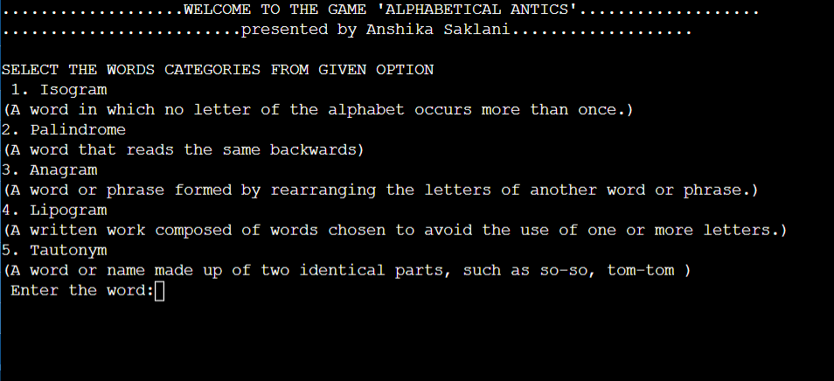
This is how the categories will be displayed on the console

Slide 7
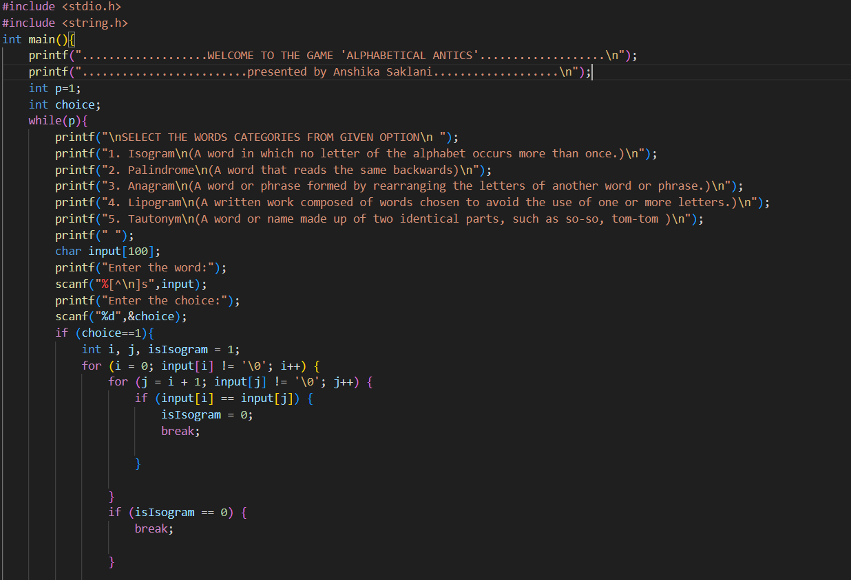
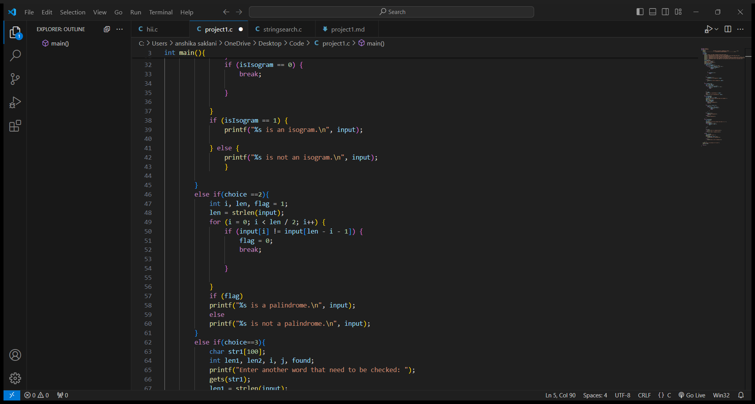

Slide 8
Thank You!
Github :https://github.com/Anshika-111105
linkedIn: www.linkedin.com/in/anshika-saklani-77a5a626a

